Slide 1
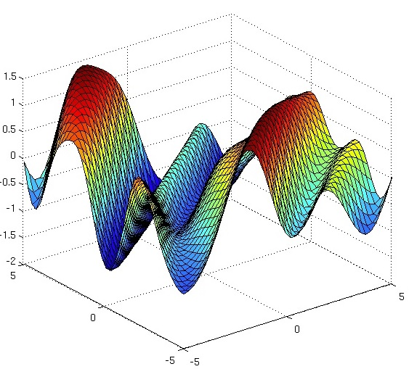
Wind Field prediction with Gaussian Processes Regression
Forest Lin
Flight Dynamics & Control
Electrical and Computer Engineering

Slide 2
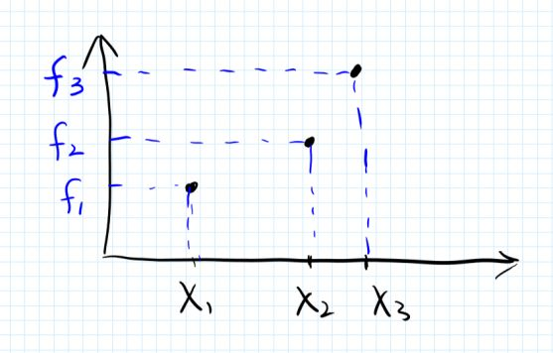
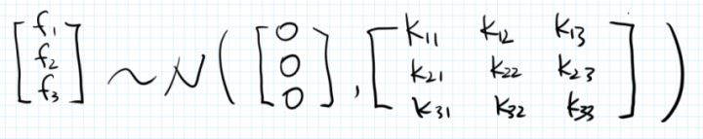
GPR Introduce

Slide 3
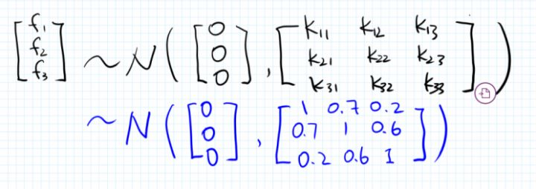
GPR Introduce

Slide 4
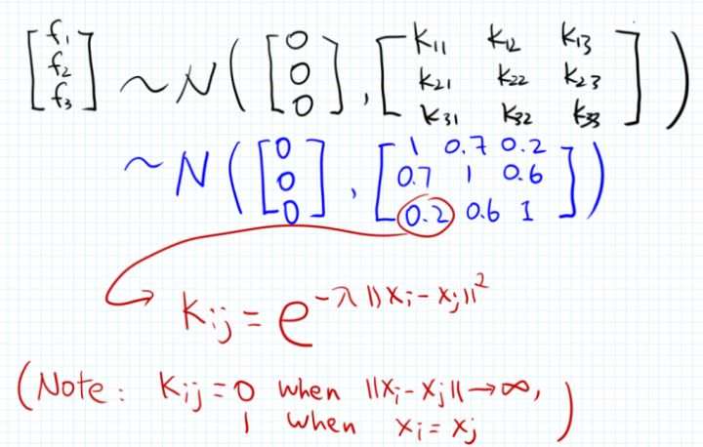
GPR Introduce

Slide 5
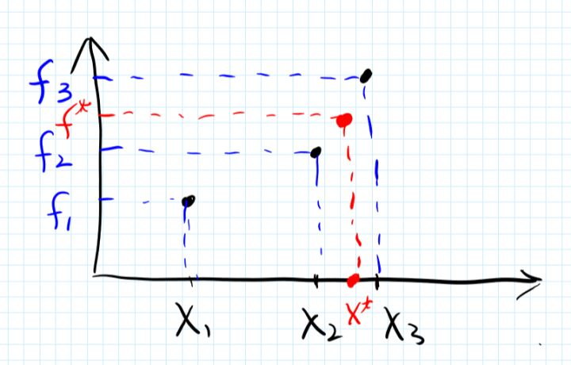
GPR Introduce

Slide 6
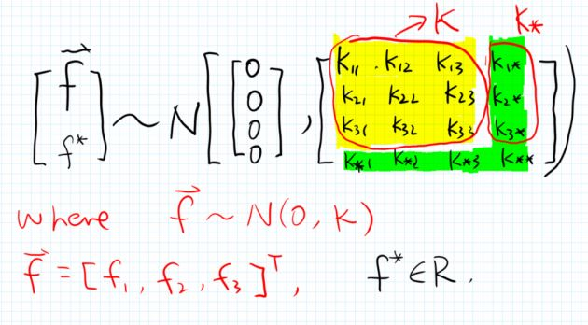
GPR Introduce

Slide 7
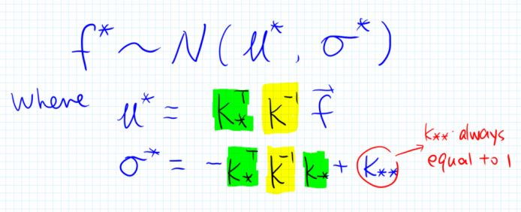
GPR Introduce
???
using the marginalization property:
1.mean
2.standard deviation

Slide 8
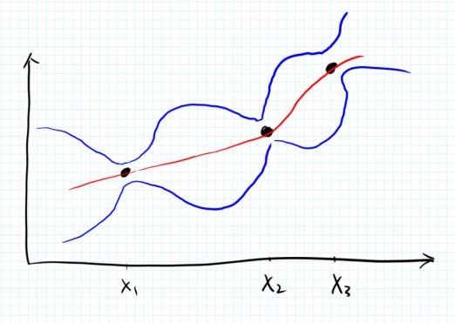
GPR Introduce

Slide 9
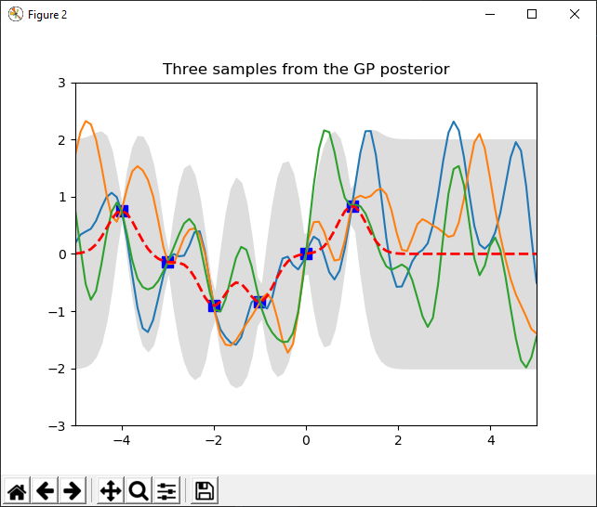
GPR Introduce

Slide 10
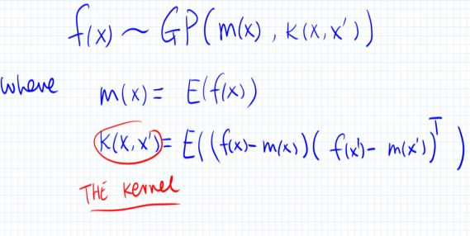

Slide 11
